Slide 1


B.Tech Project
(COCSC22)
Mid-Semester Evaluation
Stock market forecasting using financial graph network and deep learning techniques
Under the supervision
of
Dr. Preeti Kaur
Submitted by:
Adarsh Kumar- 2020UCO1663
Rohit Sharma- 2020UCO1697
Shubham Sharma- 2020UCO1705

Slide 2

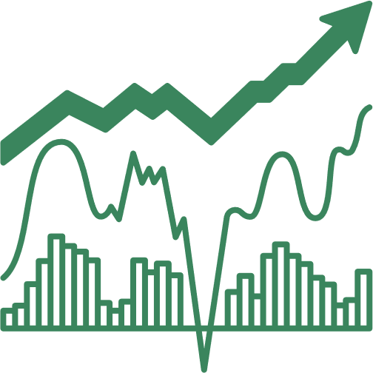
Contents
Introduction
Contributions
Literature Survey
Problem Statement
Work Flow
Dataset
Methodology
Future Work
References

Slide 3
Introduction
Stock market prediction has become a distinct field of research. Traditionally, market studies focused on manual data analysis and pattern identification in price fluctuations to forecast future market behavior.
However, the introduction of artificial intelligence has revolutionized this approach.
While applying machine learning and deep learning techniques to stock prices may seem straightforward, the manner in which they are applied can greatly influence the results.

Slide 4
Introduction
The research area in which we are going to delve is that of graphs and networks.
The research in this domain is interesting in the sense that people find general classification strategies to be much more effective in terms of stock market.
The motivation behind our study is not to accurately predict the stock market for next few days but rather predict the behavior which it “might” show in the near future based on historical data.

Slide 5
Introduction
This becomes a classification task as one needs to only consider whether the market will go up or down.
The best parameter to consider in this regard is the volatility parameter which calculates the dispersion of share price values.
It is going to be the center of this study and will significantly affect the results.

Slide 6
Contributions
The major contributions of this research include–
To experiment with various classification techniques in machine learning to predict the pattern in which the market will behave.
To have two separate classification methods, one to predict the pattern for a particular day and one to predict the behaviour of the entire graph.

Slide 7
Literature Survey
S.No | Title | Author | Description | Technology
1 | Factors Affecting Stock Prices in the UAE Financial Markets | Hussein A. Hassan et. al. | Aims to identify the key factors influencing stock prices in this emerging market. Earning per share(EPS), Money supply and GDP exhibit positive coefficient. Consumer price index demonstrates a significant negative relationship. | Regression
2 | A machine learning approach for stock price prediction | Tae Kyun Lee et.al., | This paper combines the varying markets around the world to form a network and use all of them to perform a time series forecasting on stock data using some ML algorithms such as regression, random forests and SVM. The paper uses the parameter of volatility for forecasting the Z-score of each stock indices and then applies two strategies to find out which one performs better with each algorithm. | Machine Learning
3 | Forecasting stock crash risk with machine learning | Laurens Swinkels et. al. | This paper experiments with various features in order to find out which feature is responsible towards the financial distress of a stock. It also sheds light on the use of NLP techniques in order to extract data from news articles and find the features of stock market which has the highest variability in its SHAP score. It also uses distance-to-default parameter. It mainly focuses on news articles and business news in order to predict the directions of stock market and look for crashes. | NLP

Slide 8
Literature Survey
S.No | Title | Author | Description | Technology
4 | Novel Method of Identifying Time Series Based on Network Graphs | Vanessa Freitas Silva et. al., | This study experiments with various types of time series data and then converts them into graphs. Each time series results in a separate kind of graph. The constant time series turns into a complete graph. The periodic time series like a sine graph turns into a regular graph and so on. The properties of the graph such as their centrality measures, clustering coefficient etc. gives information about the time series. | Graphs
5 | A hybrid supervised semi-supervised graph-based model to predict one-day ahead movement of global stock markets and commodity prices | Arash Negahdari Kia et. al., | This paper uses a semi-supervised approach by building a network of stock indices in the same time zone. The supervised portion of the model predicts the movement of stock market which then sends these results into the network. The research compares its results with the traditional classification methods such as KNN, SVM and Random Forests etc. with their model of HyS3 and Kruskal based graph construction. | KNN, SVM and Random Forests
6 | A method for automatic stock trading combining technical analysis and nearest neighbour classification | Rodrigo C. Brasileiro et. al., | This paper uses a nearest neighbour classifier and checks whether considering only historical data can be feasible in analysis of stock market or not. It uses technical indicators such as stop loss, stop gain, RSI filter as parameters for its own trading strategy. It compares the results of the traditional buy-and-hold strategy with its own. The variable to analyse here was profit which turned out to be better than the buy-and-hold strategy’s profit. | Nearest neighbor classifier

Slide 9
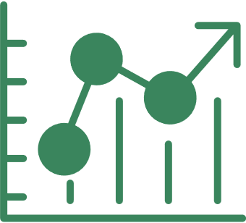
Problem Statement
To classify stock price variation patterns using various machine learning techniques and evaluate them on real data.

Slide 10
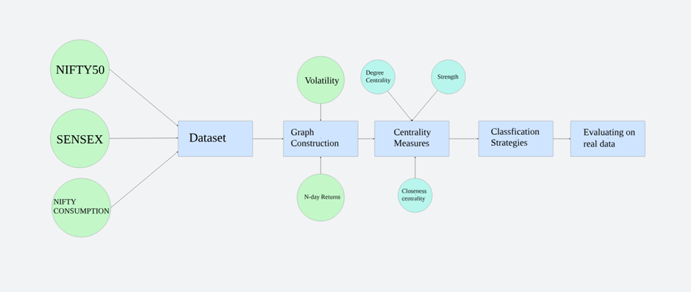
Workflow of research

Slide 11
Dataset
The dataset used in this research consists of the closing prices of 3 stock indices of India namely SENSEX, NIFTY50 and NIFTY Consumption every day from 01-01-2014 to 31-12-2023 (10 years).
SENSEX is a free-float market capitalization consisting of 30 most traded and relatively liquid stocks which contribute towards the balance of the country’s equity market.
NIFTY50 on the other hand is a benchmark index of 50 companies. NIFTY Consumption reflects the performance of companies in the domestic consumption sector.
The data for SENSEX and NIFTY50 is taken from MarketWatch and NIFTY Consumption is taken from Yahoo Finance.

Slide 12
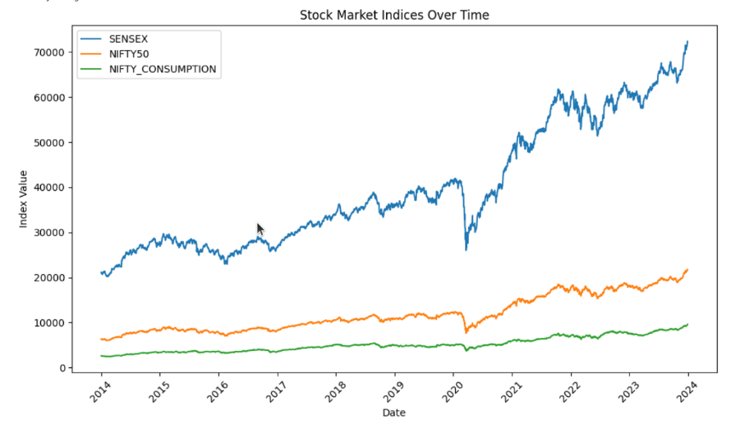
Dataset

Slide 13
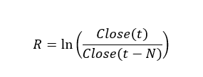
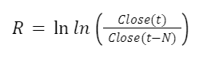
2. Creating the Graph
The graph is constructed using the study of Cao, Lin et. al. who use N-day volatility V, and N-day return R in order to divide the movement of stock index in 4 separate variations.
t refers to the current day in consideration
N refers to the number of continuous trading days
Close(t) refers to the closing price of the stock index on tth day

Slide 14
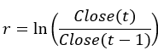
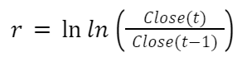
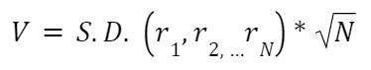
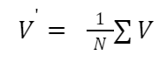
2. Creating the Graph
In order to find out V, we need to find one-day return which is r which is given by
After calculating r, we can calculate V for N days is given by
Where S.D. r₁,r₂, …r_{N} refers to the standard deviation of r₁,r₂, …r_{N}.
We can now calculate the average Volatility of the entire stock
index in question by simply averaging over the entire time series.

Slide 15
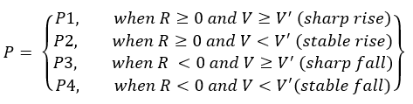
2. Creating the Graph
Now, we can classify the changes in any stock index on the basis of these parameters in the following way –
The classification is done for all the 3 indices and the combination of the patterns formed represents a node of a graph. Since the total number of combinations can be 4³ = 64, we used a 4-base number system as nodes u and v for the graph.
The graph is constructed for 60 days although experimenting with other window sizes is still a future prospect of this research.

Slide 16
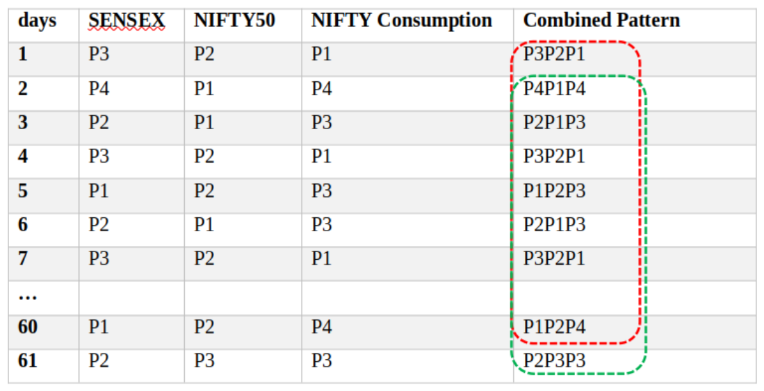
2. Creating the Graph
Table 1: Sample patterns for 7 days of data of SENSEX, NIFTY50 and NIFTY Consumption

Slide 17
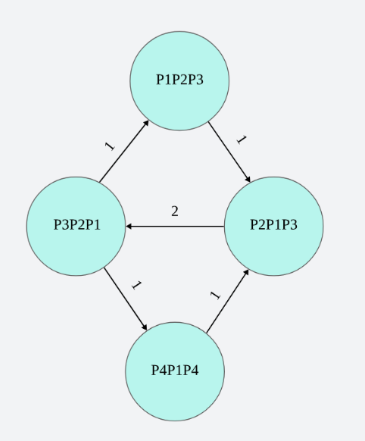
2. Creating the Graph
Figure: Example Weighted pattern graph for the data mentioned in Table 1 for the first 7 days

Slide 18
3. Centrality measures as input variables
The significance of this graph is that the denser this graph is, more is the dispersion and hence more care needs to be taken by investors while investing. Hence, we consider certain centrality measures in order to feed them as characteristics of our graph for classification on unseen data.
The measure we are considering for this research are degree centrality, strength (as described by Cao, Lin et. al.), closeness centrality and betweenness centrality. So far, we have applied the KNN algorithm for degree centrality and strength of the network.

Slide 19
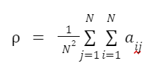
3. Centrality measures as input variables
3.1 Network Average Degree Centrality
In undirected networks, the average degree centrality of the network reflects the level of connection between one node and other nodes in the network, that is, whether one node is connected with the other nodes or not. The formula is as follows:
We connect the nodes in time order so that the in-degree
and the out-degree are the same except for the first node
and the last node. Therefore, we only select the in-degree
for analysis, and calculate the average in-degree centrality
as follows:

Slide 20
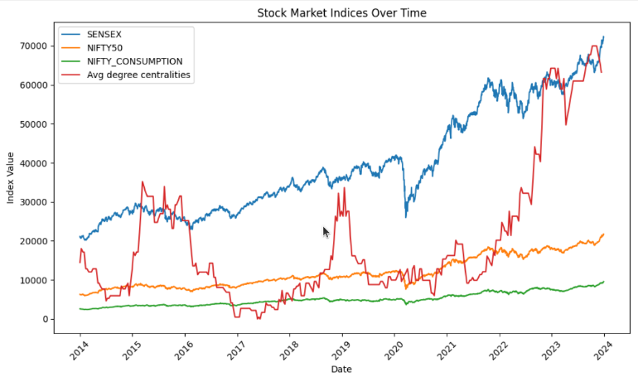
3. Centrality measures as input variables

Slide 21
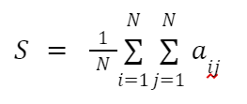
3. Centrality measures as input variables
3.2 Average Network Strength
In a network, the strength of the connection from node to node is the weight of the directed edge from node to node. Similar to the in-degree and out-degree of the directed network, the strength of the directed weighted network can also be divided into in-strength and out-strength. In this study, we describe average out-strength as average network strength:
The greater the average strength of the network, the fewer the number of network nodes, the simpler the composition of the price volatility patterns, the smaller the complexity of the network, and the higher the frequency of the same node. The simpler price patterns reflect the fact that the consistency of price changes of different stocks is stronger and lasts for longer.

Slide 22
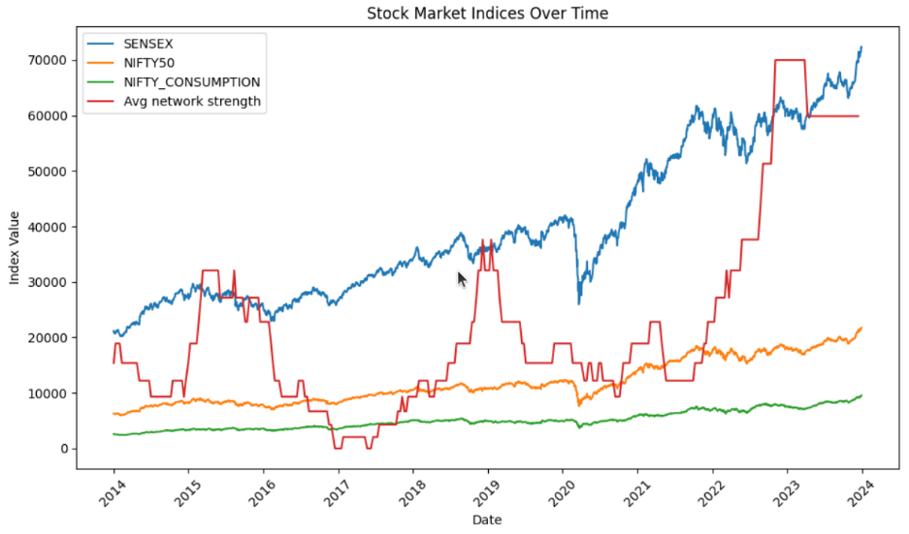
3. Centrality measures as input variables

Slide 23
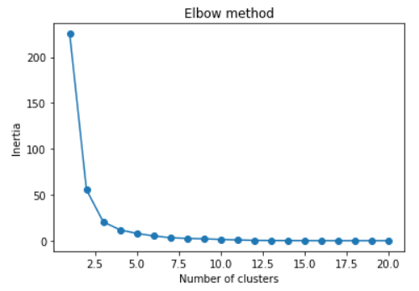
K-Means Clustering
Figure: K-Means Clustering using two centrality measures – Average Network Strength and Average Degree Centrality

Slide 24
Future Work
The following are the major contributions of this research which are yet to come in the future:
Applying various classification methods including SVM, random forest, deep learning strategies including neural networks in order to compare the strategies and find out the best one. We will also consider ensemble techniques by combining multiple classification strategies together.
Currently, we worked with only two centrality measures. In the future, we will work with more centrality measures such as betweenness centrality and closeness centrality in order to increase the input variables for classification algorithms.

Slide 25
Future Work
The following are the major contributions of this research which are yet to come in the future:
We will also practically apply these machine learning techniques by using them through various investment strategies in trading simulators to better evaluate our results.
Currently, a window size of 60 days is only considered. However, graphs with other window sizes will also be considered on which these algorithms will be applied again. This will generate more results.

Slide 26
References
[1] Lucas Lacasa, Bartolo Luque, Fernando Ballesteros, Jordi Luque and Juan Carlos Nun. From time series to complex networks: The visibility graph
[2] Yung-Keun Kwon, Sung-Soon Choi and Byung-Ro Moon. Stock Prediction based on Financial Correlation.
[3] Ying Li, Hongduo Cao and Yong Tan. Novel Method of Identifying Time Series Based on Network Graphs. Department of Management Science, Business School, Sun Yat-Sen University, Guangzhou 510275, China
[4] Minggang Wang, Ying Chen, Lixin Tian, Shumin Jiang, Zihao Tian, Ruijin Du. Fluctuation behaviour analysis of international crude oil and gasoline price based on complex network perspective. Accepted at Elsevier, May 2016.
[5] Michel Ballings, Dirk Van den Poel, Nathalie Hespeels, Ruben Gryp. Evaluating multiple classifiers for stock price direction prediction. Accepted at Elsevier, May 2015.
[6] Lamartine Almeida Teixeira, Adriano Lorena Inácio de Oliveira. A method for automatic stock trading combining technical analysis and nearest neighbour classification. Accepted at Elsevier.
[7] Hongduo Cao, Tiantian Lin, Ying Li, and Hanyu Zhang. Stock Price Pattern Prediction Based on Complex Network and Machine Learning. Accepted at Wiley, May 2019
[8] Arash Negahdari Kiaa, Saman Haratizadeha, Saeed Bagheri Shourakib. A hybrid supervised semi-supervised graph-based model to predict one-day ahead movement of global stock markets and commodity prices. Accepted at Expert Systems with Applications, March 2018
[9] Jan Grudniewicz, Robert Slepaczuk. Application of machine learning in algorithmic investment strategies on global stock markets. Accepted at Elsevier, July 2023.
[10] Tae Kyun Leea, Joon Hyung Chob, Deuk Sin Kwonb, So Young Sohnb. Global stock market investment strategies based on financial network indicators using machine learning techniques. Accepted at Expert Systems with Applications, September 2018.
[11] Hussein A. Hassan Al-Tamimi, Ali Abdulla Alwan & A. A. Abdel Rahman. Factors Affecting Stock Prices in the UAE Financial Markets. Accepted at Transnational Management, March, 2011.

Slide 27



Any questions? We will try our best to answer.

Slide 28


THANK YOU
Contact us: kumar.adarsh0042@gmail.com
Presented by Adarsh Kumar, Rohit Sharma, Shubham Sharma

